Slide 1











CoMID: Context-based Multi-Invariant Detection for Monitoring Cyber-Physical Software
Yi Qin, Tao Xie, Chang Xu, Angello Astorga, Jian Lu

Slide 2
Outlines
Background
Cyber-physical system programs
Runtime monitoring of CPS programs
CoMID approach
Context-based trace grouping
Multi-invariant detection
Evaluation on NAO robots and UAVs
Conclusion

Slide 3





Cyber-physical system programs
Self-driving
Bridge Monitoring
Autopilot
Robots

Slide 4
Execution of a CPS program
Continually interacting with its physical environment
Iteration: one pass of the program-environment interaction loop
Suffering from uncertainty
U
E
P

Slide 5



Failures of CPS programs
Crash of Tesla Model S
Crash of Lion Air Flight 610
Uber self-driving car kills pedestrian

Slide 6
Runtime monitoring for CPS programs
Detecting a CPS program’s abnormal states during its execution
Avoiding high-cost failures
How does one decide whether the program enters an abnormal state (error)?

Slide 7
Specifying abnormal states
Manually specified properties
Non-trivial
High-cost
Automatically generated invariants
Collecting passing execution traces
Deriving invariants based on the traces
Using the invariants to detect abnormal states
The quality of invariants determines
the quality of abnormal-state-detection

Slide 8




Our objective
How to derive high-quality invariants
for monitoring CPS programs ?
Frequent false alarms
Easy to miss error
General invariants
Specific invariants
Deriving
Violation caused by sensing error
Uncertainty
Monitoring
False alarm

Slide 9
Our objective
How to derive high-quality invariants
for monitoring CPS programs ?
How to balance general and specific invariants ?
How to alleviate the impact of uncertainty ?

Slide 10
CoMID approach
Context-based Multiple Invariants Detection
Using contexts to specify effective scopes of derived invariants
Deriving specific invariants while avoiding using them in inappropriate situations
Using multi-invariants to balance the impact of uncertainty
Balancing uncertainty’s impact between different collected executions (during invariant generation)
Balancing uncertainty’s impact between different iterations (during invariant detection)

Slide 11
Approach overview
Trace collection
Trace grouping
Multi-invariant generation
Multi-invariant detection
Co-context
P
E
Multi-invariant
Trace grouping
Multi-invariant generation
Multi-invariant detection
Human-specified
passing traces
P
E
Co-context iterations

Slide 12
1. Context-based trace grouping
Collecting program and environmental contexts for each iteration to specify an invariant’s scope
Program context: executed statements
Environmental context: values of environment sensing variables
Grouping iterations by their contexts
Environmental context: using K-means clustering
Program context: using Jaccard similarity index

Slide 13
2. Multi-invariant generation
Using different subsets from each group of context-sharing iterations to derive invariants
Balancing the impact of uncertainty in different subsets
Resembling the intuition of Ensemble Learning
Multiple models perform better than one model
Sampling subsets randomly with different sizes
Feeding iterations from each subset to invariant inference engine (e.g., Daikon, Dysy) to derive multi-invariants

Slide 14
3. Multi-invariant detection
Assigning a weight to the checking result of a multi-invariant’s each included invariant
The weight of an invariant’s violation or satisfaction relates to the corresponding subset’s size
Violating: larger size (more general), larger weight
Satisfying: smaller size (more specific), larger weight
Collective checking for multi-invariants across multiple iterations to balance uncertainty
Comparing the average weight with a pre-defined threshold value (related to the uncertainty types)

Slide 15
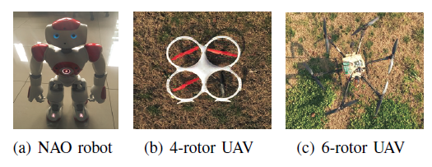
Evaluation
Subjects
Offline experiments: whether the approach can detect abnormal states on collected execution traces
TP and FP of the detection
Online experiments: whether the approach can detect abnormal states during programs' executions
Successful rate of the monitored executions

Slide 16
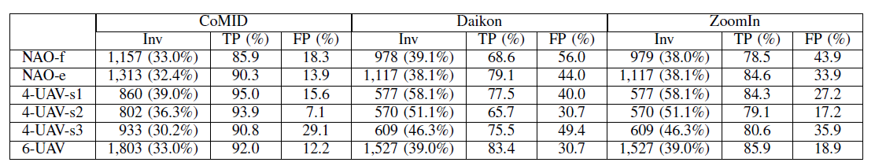
Offline experiments
Detecting abnormal states on collected execution traces
Daikon: a widely-used invariant generation tool
ZoomIn: considering program context in invariant generation
Our approach
NAO robot
4-rotor UAV
Failed executions,
abnormal states detected correctly
Passing executions,
abnormal states detected wrongly
6-rotor UAV
CoMID achieves a 6.8-37.6% lower FP rate
CoMID derives more unique invariants
CoMID achieves a 5.7-28.2% higher TP rate

Slide 17
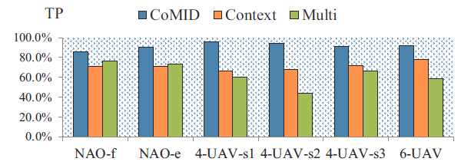
Offline experiments
Comparison of CoMID’s different configurations
Enable context-based trace grouping only
Original configuration
Enable multi-invariant detection only
Trace grouping provides specific invariants, which results in a higher TP
NAO robot faces more severe uncertainty, which multi-invariant detection favors

Slide 18
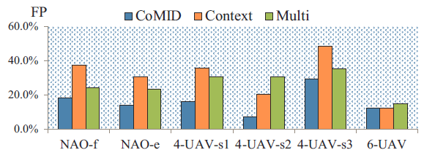
Offline experiments
Comparison of CoMID’s different configurations
Enable context-based trace grouping only
Original configuration
Enable multi-invariant detection only
Multi-invariant detection alleviates the impact of uncertainty, which results in a lower FP

Slide 19
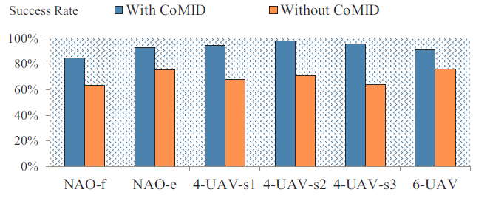
Online experiments
Runtime monitoring CPS programs
Triggering a protection mechanism (e.g., stop walking for the robot) when abnormal states are detected
The percentage of executions that finish without failure
CoMID helps improve the subjects’ success rate in their task executions by 15.3–31.7%

Slide 20
Conclusion
CoMID approach
Effectively generating and checking invariants to detect abnormal states for CPS programs
Achieving a higher TP and lower FP
CoMID’s two key techniques
Context-based trace grouping: using program and environmental contexts to specify an invariant’s scope
Multi-invariant detection: using multiple invariant checking results to balance the impact of uncertainty

Slide 21
Thank you!
Q&A
Yi Qin, borakirchies@163.com

Slide 22
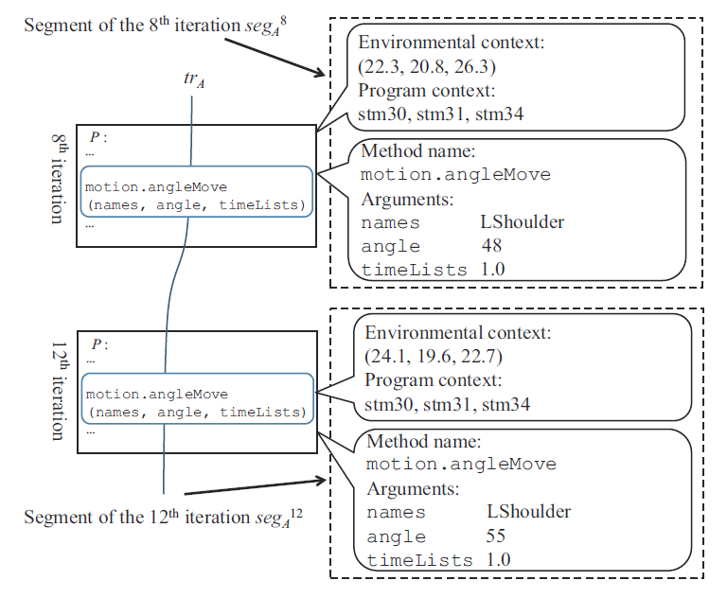
Backup：trace collection

Slide 23
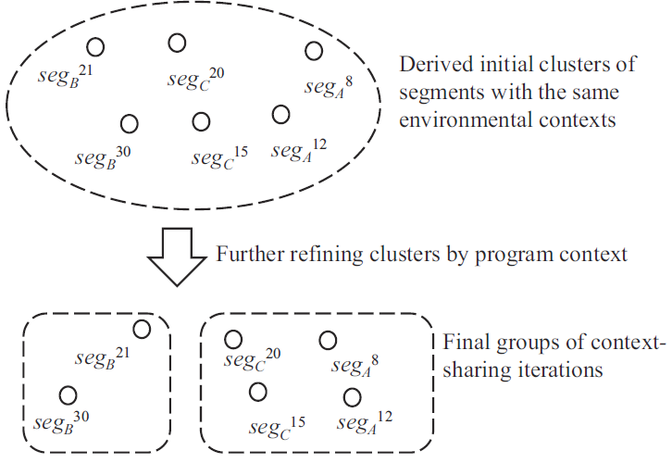
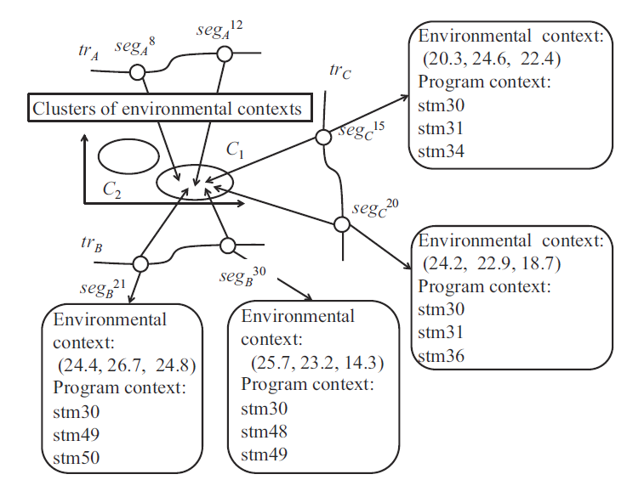
Backup：trace grouping

Slide 24
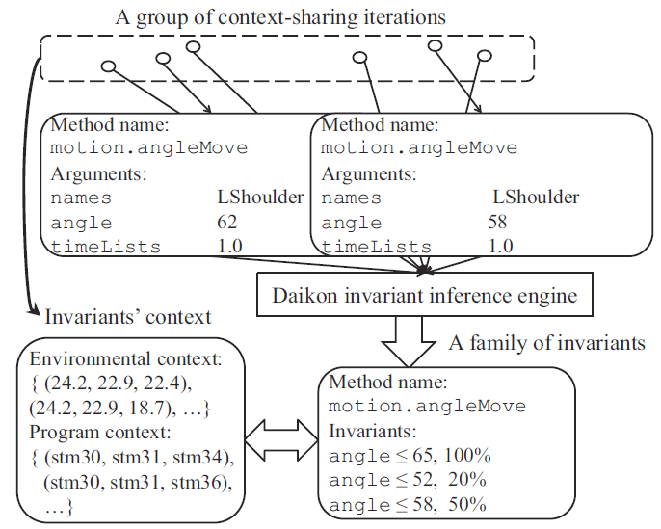
Backup：multi-invariant generation

Slide 25
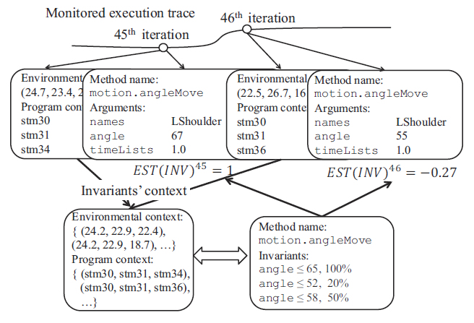
Backup：multi-invariant detection

